Slide 1
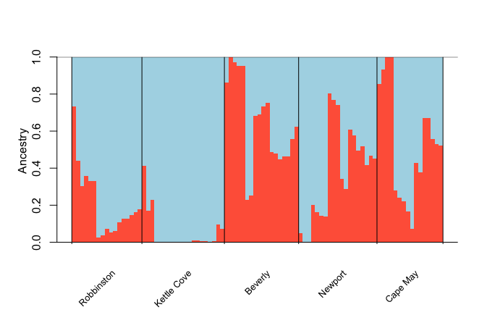
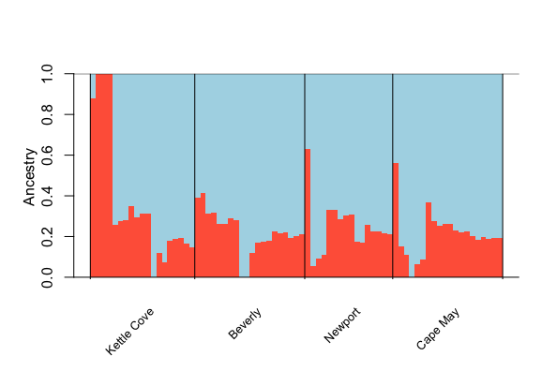
C. fornicata
C. plana
Notes:
Pcangsd

Slide 2
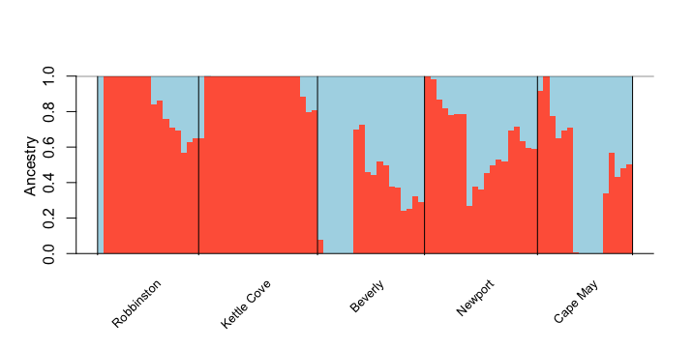
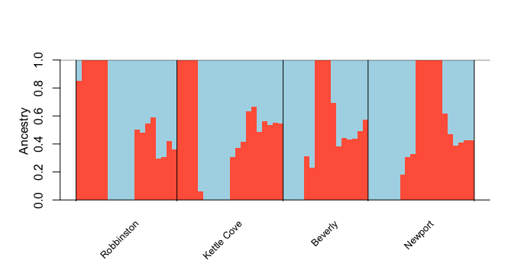
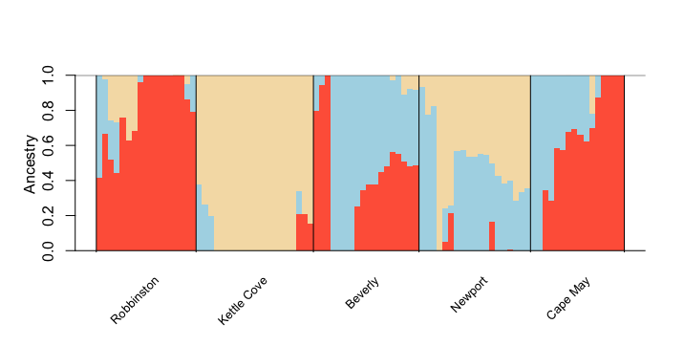
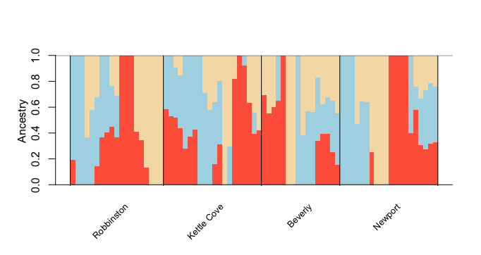
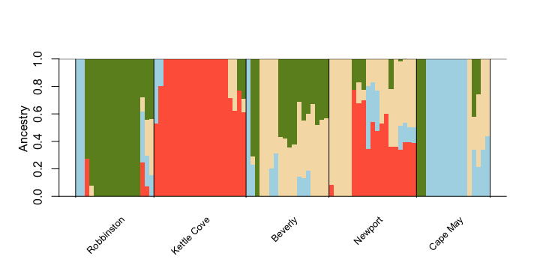
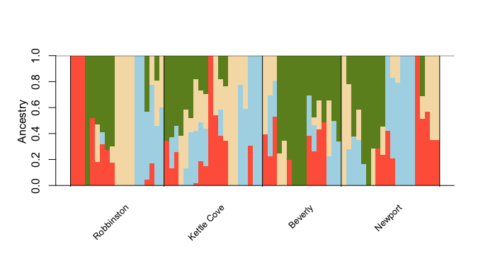
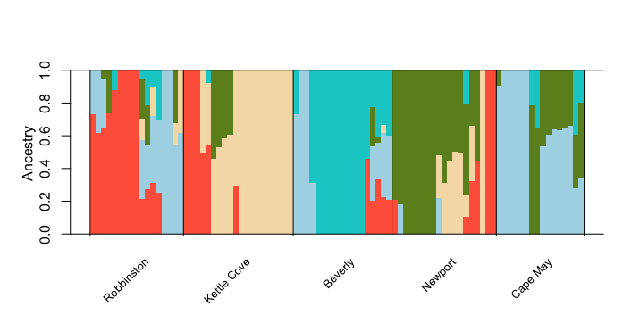
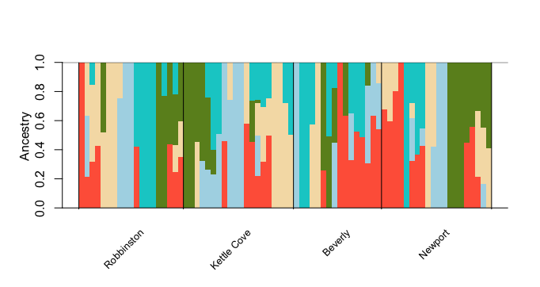
C. fornicata
C. plana

Slide 3
C. fornicata

Slide 4
C. plana
Notes:
Will Lush – larva connectivity

Slide 5
C. fornicata
 | Robbinston
Kettle Cove | 0.019868 | Kettle Cove
Beverly | 0.018382 | 0.020613 | Beverly
Newport | 0.023154 | 0.022944 | 0.023183 | Newport
Cape May | 0.028121 | 0.028155 | 0.01562 | 0.020421

Slide 6
C. fornicata
 | Robbinston
Kettle Cove | 0.019868 | Kettle Cove
Beverly | 0.018382 | 0.020613 | Beverly
Newport | 0.023154 | 0.022944 | 0.023183 | Newport
Cape May | 0.028121 | 0.028155 | 0.01562 | 0.020421

Slide 7
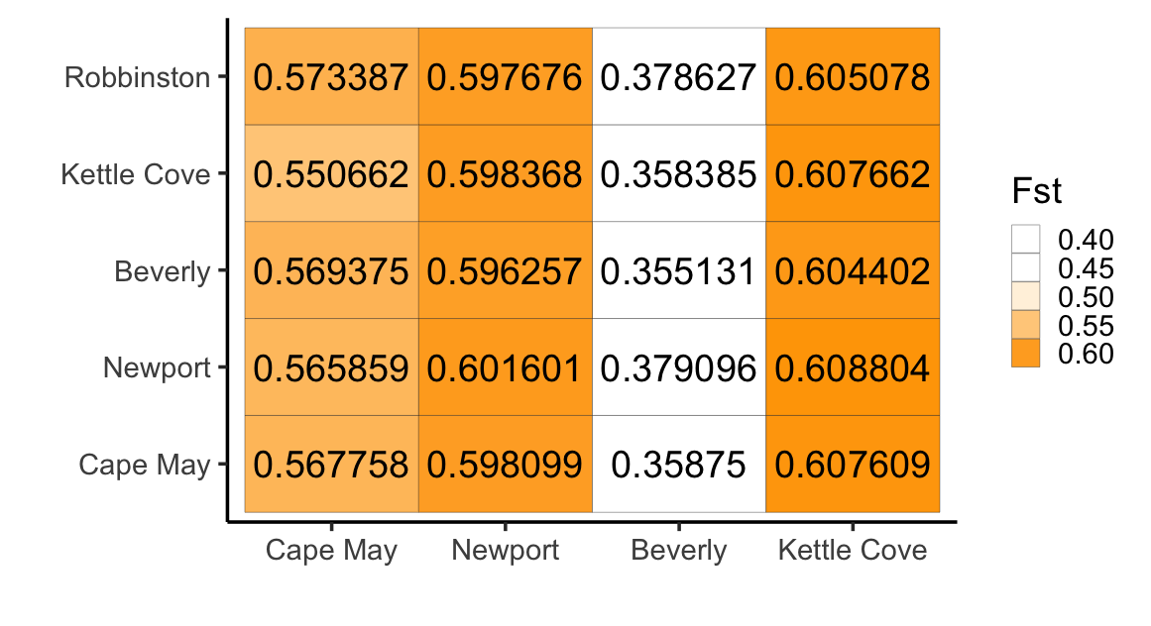
Crepidula fornicata
Crepidula plana

Slide 9
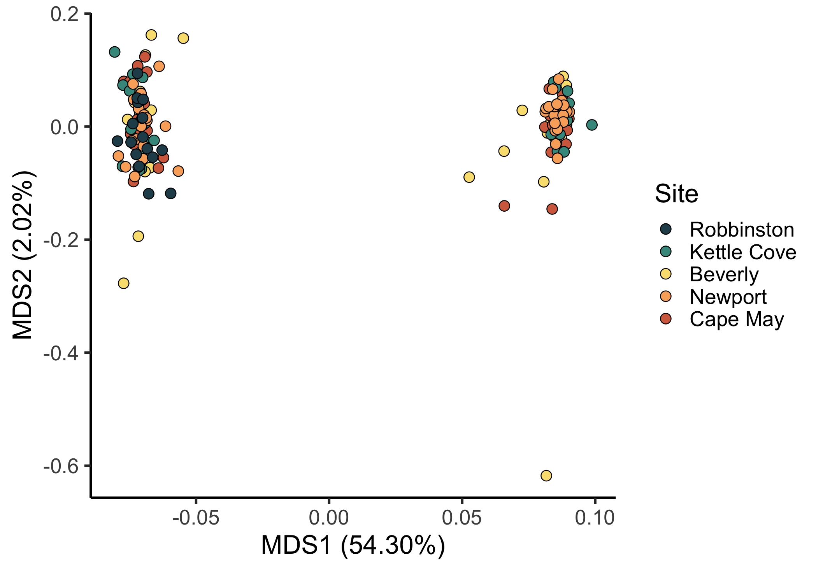

Slide 10
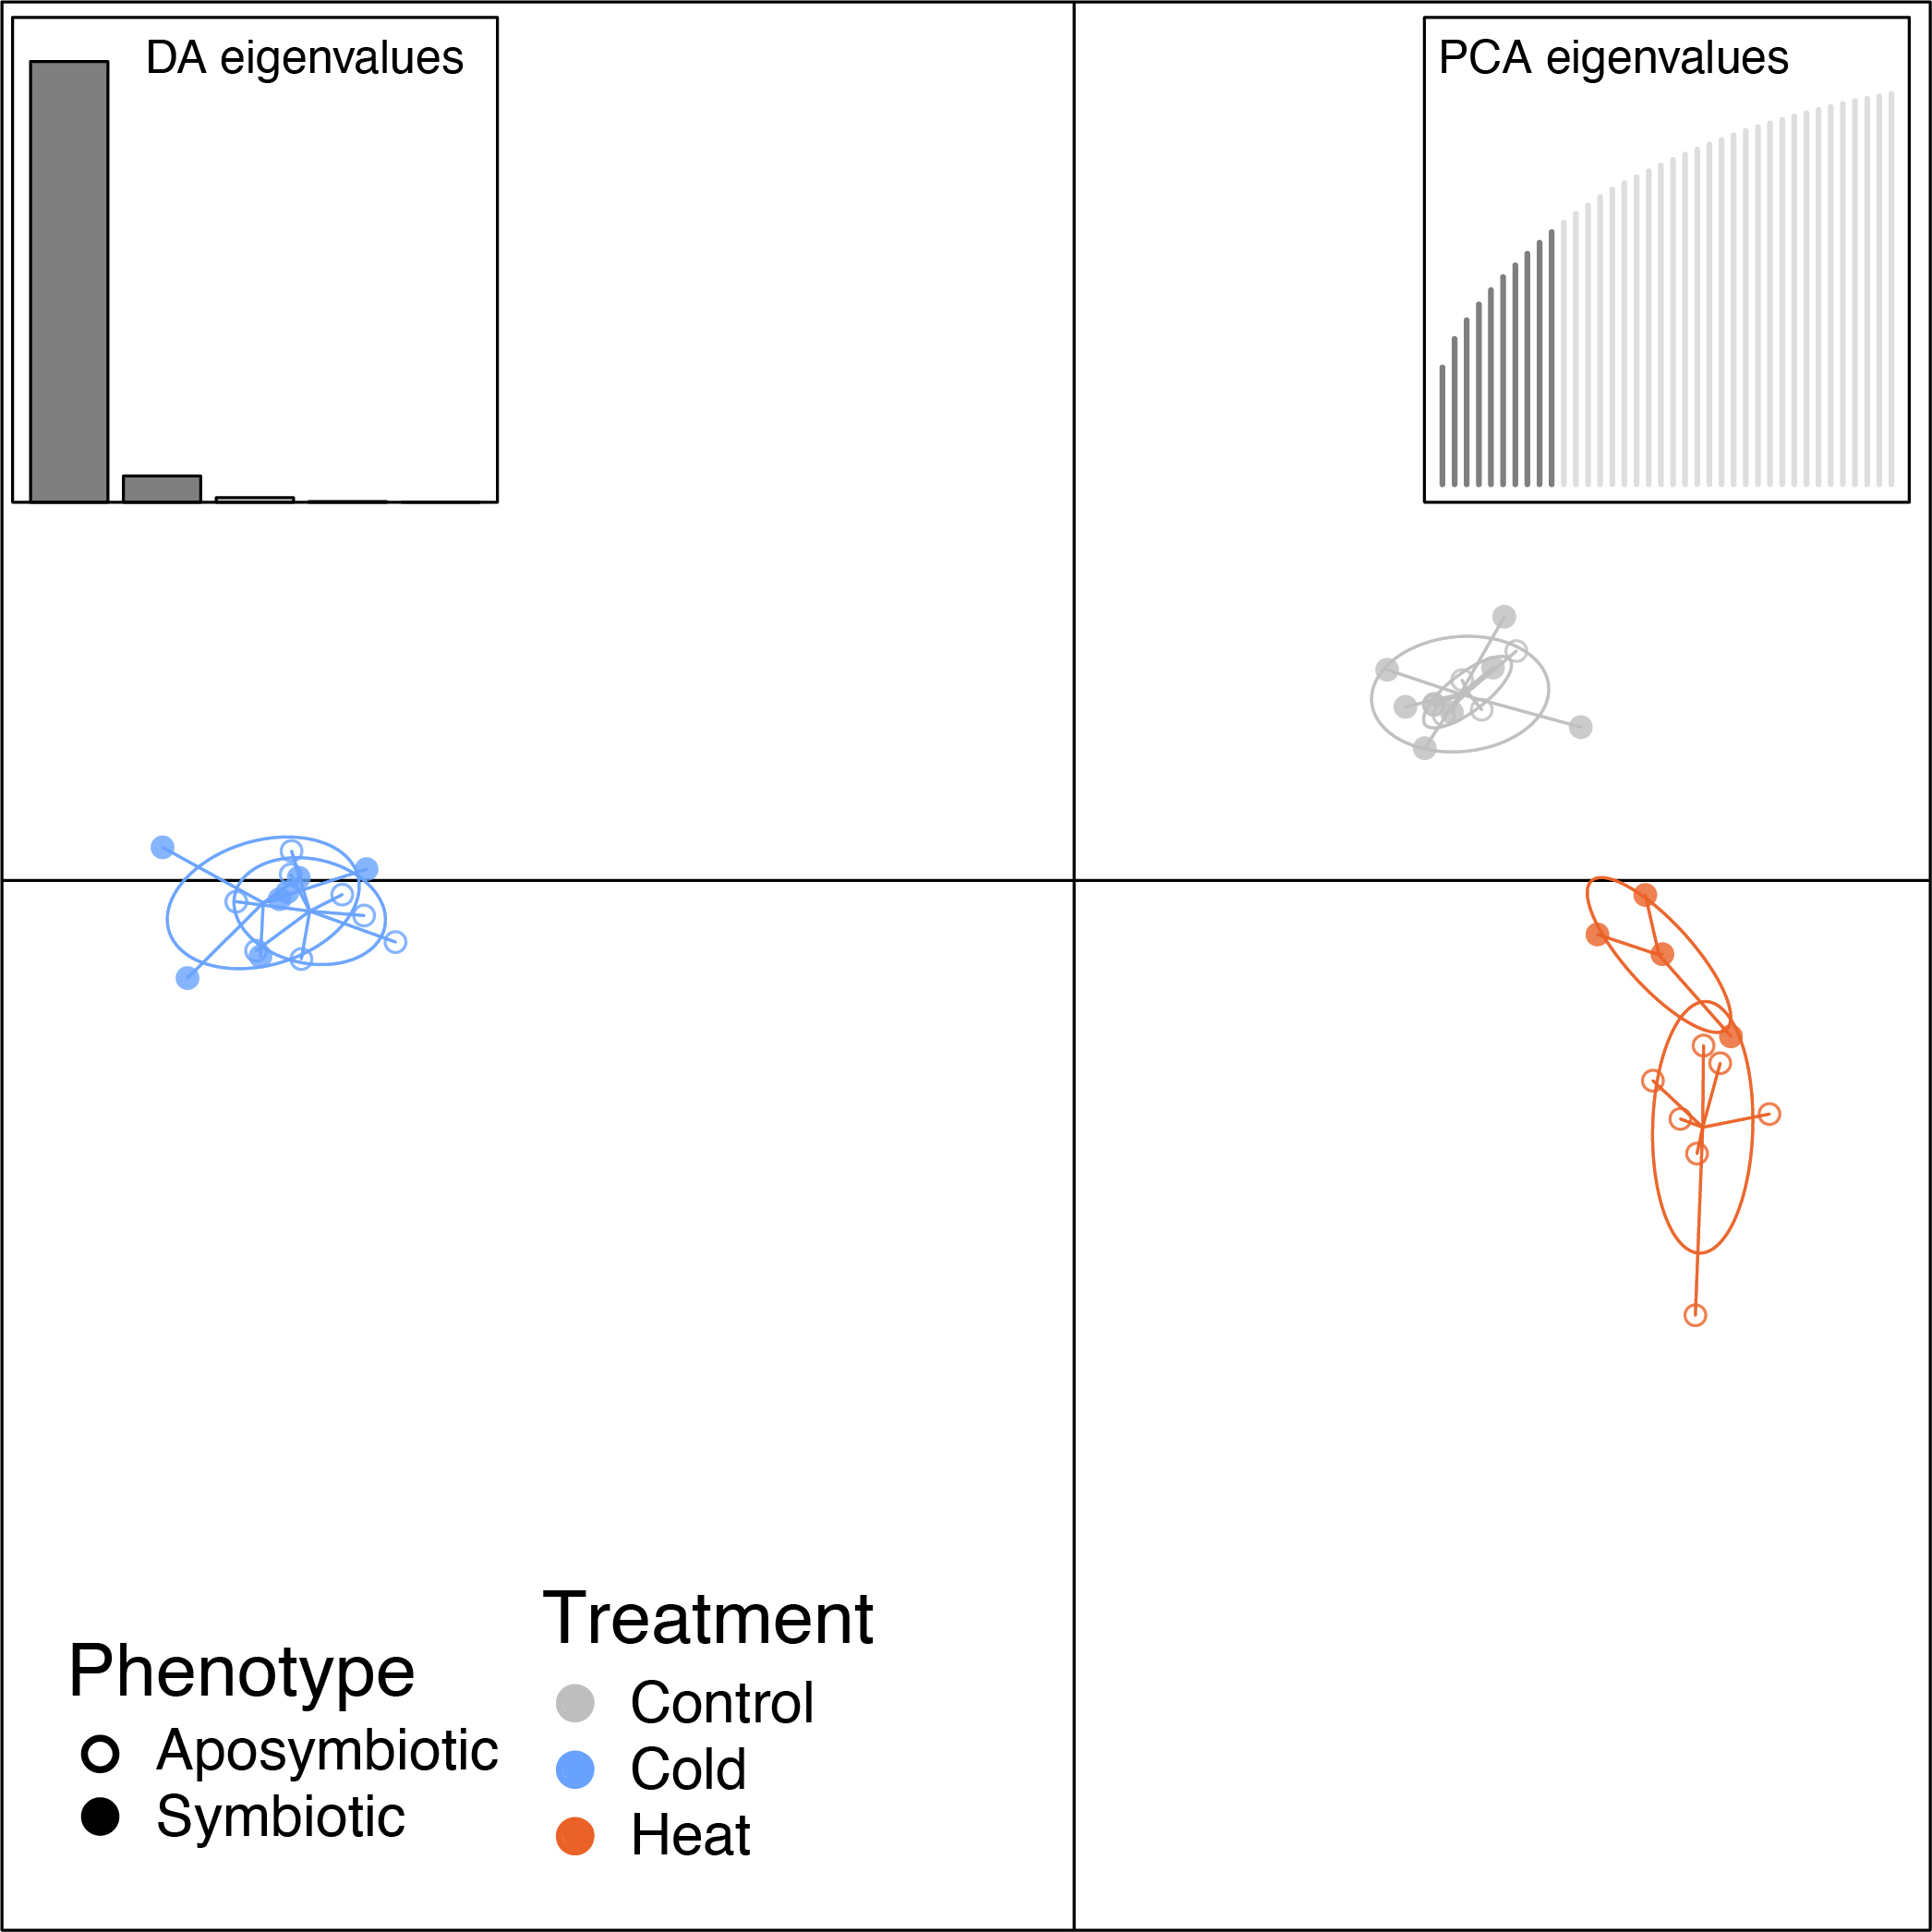

Slide 11
 | Robbinston
Kettle Cove | 0.019868 | Kettle Cove
Beverly | 0.018382 | 0.020613 | Beverly
Newport | 0.023154 | 0.022944 | 0.023183 | Newport
Cape May | 0.028121 | 0.028155 | 0.01562 | 0.020421
 | Kettle Cove
Beverly | 0.007857 | Beverly
Newport | 0.013728 | 0.007064 | Newport
Cape May | 0.013758 | 0.007872 | 0.009557

Slide 12
C. fornicata
 | Robbinston
Kettle Cove | 0.019868 | Kettle Cove
Beverly | 0.018382 | 0.020613 | Beverly
Newport | 0.023154 | 0.022944 | 0.023183 | Newport
Cape May | 0.028121 | 0.028155 | 0.01562 | 0.020421
C. plana
 | Kettle Cove
Beverly | 0.007857 | Beverly
Newport | 0.013728 | 0.007064 | Newport
Cape May | 0.013758 | 0.007872 | 0.009557

Slide 13
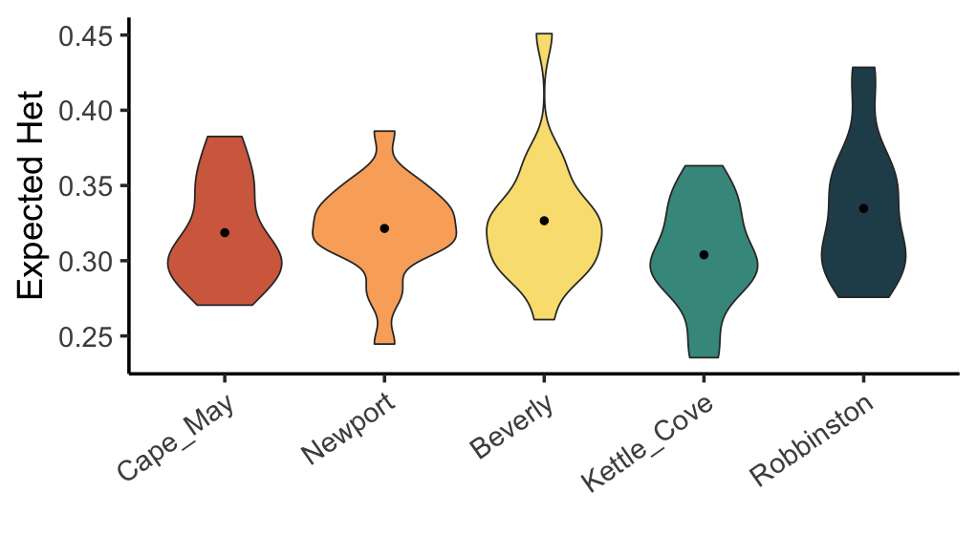
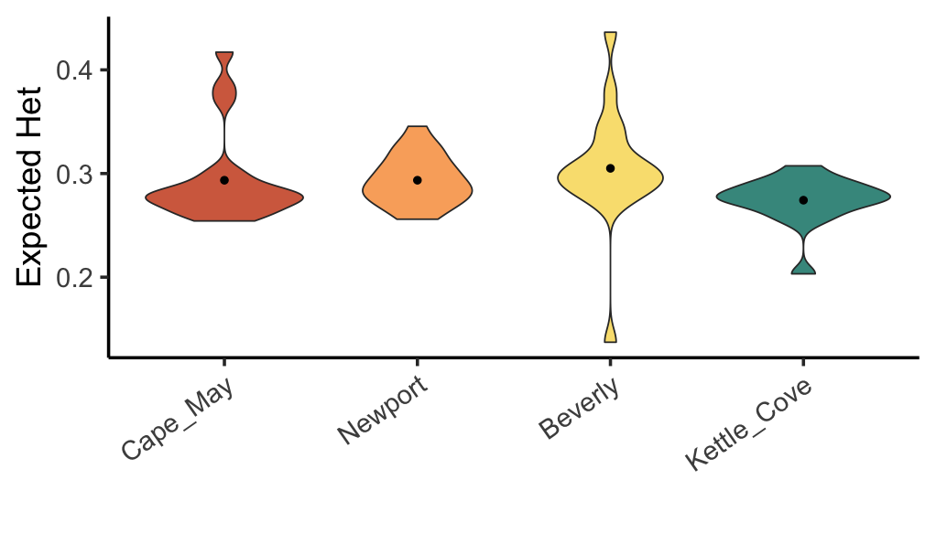
Notes:
-minMaf 0.05

Slide 14
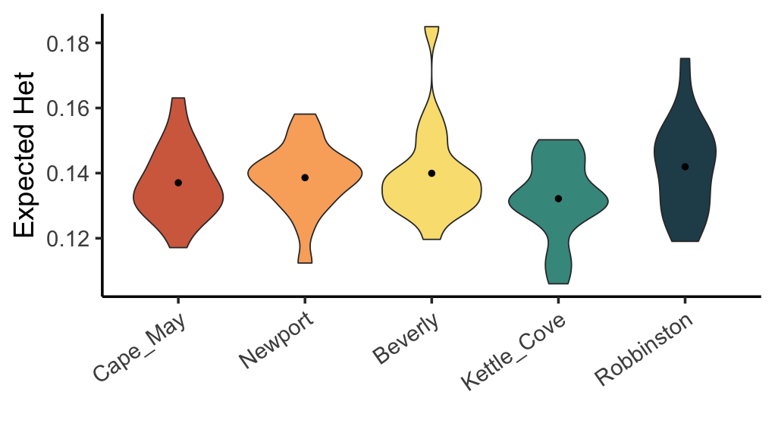
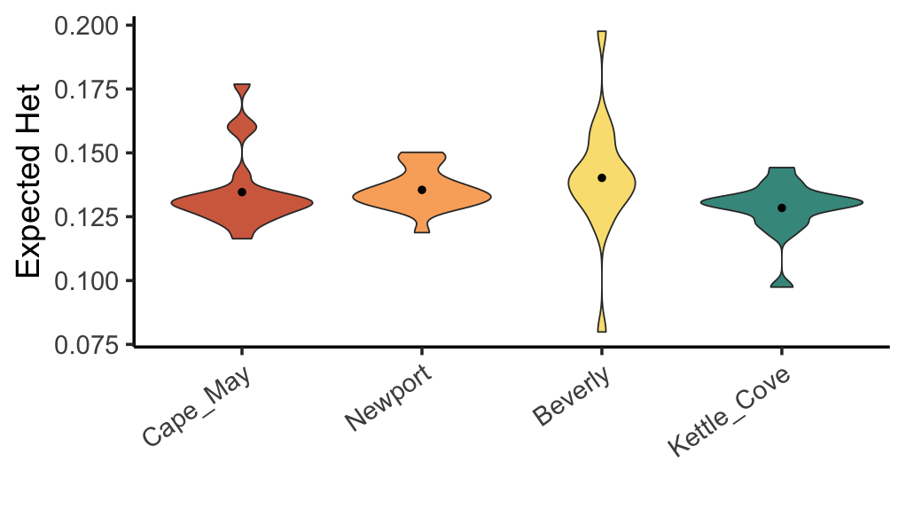
Notes:
-min maf filter removed

Slide 15
C. fornicata
Notes:
Fornicata. All, neutral, outlier

Slide 16
C. plana
Notes:
Plana. All, neutral, outlier

